Slide 1
GIT
Training

Slide 2
Git Essentials
Are you new to the programming world, and looking to quickly ramp up with the most popular tools to accelerate the learning journey?
Then learning Git should be something on top of your priority list!
Git is one such tool that you will encounter on a day-to-day basis as part of your job.
It supports all the programming languages and operating systems.
It is an important and popular technology in software development.
It is used by both software and non-software professionals.

Slide 3
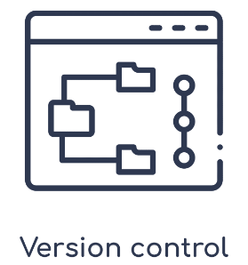
Version Control
It is a process that allows us to track the changes in the files.
Version Control solves the problem by tracking the document versions.

Slide 4
What is Git?
A version control system.
It tracks changes made to any kind of file, including source code, words docs, audio, and image files.
It enables us to revert or revoke changes done to a single file or a set of files, even after we modified them.
It can compare the changes made to files between different versions.
A mature and actively maintained open-source project.
It was created by Linus Torvalds in 2005.
It is released under GPL’s open-source license.
It is free to download and use.
It has a distributed architecture. Anyone can request the latest version of the work from this server and if required, push the latest changes back to the server.
It is fast and small.
It does not rely on the central server.
As most of the operations performed locally, and it gives a huge benefit in terms of speed.
Though Git mirrors the entire repository, the size of the data on the machine is relatively small.
It is designed to be secure and flexible, making it the de-facto choice for most software teams and enterprises.
It is used by the tech giants like Amazon, Google, Microsoft, Instagram, and almost all the big entities that you have heard of uses GIT for managing their code.

Slide 5
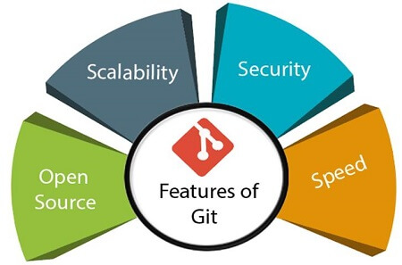
Features of Git
Open Source
Git is an open-source tool. It is released under the GPL (General Public License) license.
Scalable
Git is scalable, which means when the number of users increases, the Git can easily handle such situations.
Distributed
One of Git's great features is that it is distributed. Distributed means that instead of switching the project to another machine, we can create a "clone" of the entire repository.
Security
Git is secure. It uses the SHA1 (Secure Hash Function) to name and identify objects within its repository.
Speed
Git is very fast, so it can complete all the tasks in a while.
Supports non-linear development
Git supports seamless branching and merging, which helps in visualizing and navigating a non-linear development.
Branching and Merging
Git allows the creation of multiple branches without affecting each other. We can perform tasks like creation, deletion, and merging on branches, and these tasks take a few seconds only.
Data Assurance
The Git data model ensures the cryptographic integrity of every unit of our project. It provides a unique commit ID to every commit through a SHA algorithm.
Staging Area
The Staging area is also a unique functionality of Git. It can be considered as a preview of our next commit, moreover, an intermediate area where commits can be formatted and reviewed before completion.
It is possible to quickly stage some of our files and commit them without committing other modified files in our working directory.
Maintain the clean history
Git facilitates with Git Rebase; It is one of the most helpful features of Git. It fetches the latest commits from the master branch and puts our code on top of that. Thus, it maintains a clean history of the project.

Slide 6
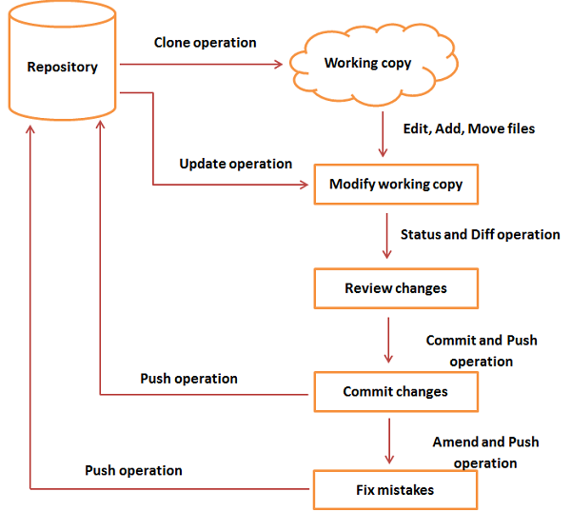
Git - Life Cycle
You clone the Git repository as a working copy.
You modify the working copy by adding/editing files.
If necessary, you also update the working copy by taking other developer's changes.
You review the changes before commit.
You commit changes. If everything is fine, then you push the changes to the repository.
After committing, if you realize something is wrong, then you correct the last commit and push the changes to the repository.

Slide 7
Install Git on Windows
To download the Git installer, visit the Git's official site and go to download page.
The link for the download page is
https://git-scm.com/downloads

Slide 8
Install Git on Ubuntu
Start the General OS and Package update
$ apt-get update
Install Git
$ apt-get install git-core
Confirm Git the installation
$ git --version
Output: git version 2.33.0
Configure the Git for the First use
To register a username, run the below command:
$ git config --global user.name "NewProjects"
To register an email address for the given author, run the below command:
$ git config --global user.email "abc@xyz"

Slide 9
Get Started with GitHub
To get started with GitHub follow these two steps.
Create a GitHub account.
Push the git repository to GitHub.

Slide 10
Create your public Web repository
Sign-up in
https://github.com/
And create a public repository.

Slide 11
Git Terminology
Git is a tool that covered vast terminology and jargon, which can often be difficult for new users, or those who know Git basics but want to become Git masters. So, we need a little explanation of the terminology behind the tools.
Some commonly used terms are:
Branch
A branch is a version of the repository that diverges from the main working project. It is an essential feature available in most modern version control systems.
A Git project can have more than one branch.
We can perform many operations on Git branch-like rename, list, delete, etc.
Checkout
In Git, the term checkout is used for the act of switching between different versions of a target entity.
The git checkout command is used to switch between branches in a repository.

Slide 12
Git Terminology
Some commonly used terms are:
Cherry-Picking
Cherry-picking in Git is meant to apply some commit from one branch into another branch.
In case you made a mistake and committed a change into the wrong branch, but do not want to merge the whole branch.
You can revert the commit and cherry-pick it on another branch.
Clone
The git clone is a Git command-line utility.
It is used to make a copy of the target repository or clone it.
If I want a local copy of my repository from GitHub, this tool allows creating a local copy of that repository on your local directory from the repository URL.
Fetch
It is used to fetch branches and tags from one or more other repositories, along with the objects necessary to complete their histories.
It updates the remote-tracking branches.

Slide 13
Git Terminology
Some commonly used terms are:
HEAD
HEAD is the representation of the last commit in the current checkout branch.
We can think of the head like a current branch.
When you switch branches with git checkout, the HEAD revision changes, and points the new branch.
Index
The Git index is a staging area between the working directory and repository.
It is used as the index to build up a set of changes that you want to commit together.
Master
Master is a naming convention for Git branch.
It's a default branch of Git.
After cloning a project from a remote server, the resulting local repository contains only a single local branch.
This branch is called a "master" branch. It means that "master" is a repository's "default" branch.

Slide 14
Git Terminology
Some commonly used terms are:
Merge
Merging is a process to put a forked history back together.
The git merge command facilitates you to take the data created by git branch and integrate them into a single branch.
Origin
In Git, "origin" is a reference to the remote repository from a project was initially cloned.
More precisely, it is used instead of that original repository URL to make referencing much easier.
Pull/Pull Request
The term Pull is used to receive data from GitHub.
It fetches and merges changes on the remote server to your working directory.
The git pull command is used to make a Git pull.
Pull requests are a process for a developer to notify team members that they have completed a feature.
Once their feature branch is ready, the developer files a pull request via their remote server account.
Pull request announces all the team members that they need to review the code and merge it into the master branch.

Slide 15
Git Terminology
Some commonly used terms are:
Push
The push term refers to upload local repository content to a remote repository.
Pushing is an act of transfer commits from your local repository to a remote repository.
Pushing is capable of overwriting changes; caution should be taken when pushing.
Rebase
In Git, the term rebase is referred to as the process of moving or combining a sequence of commits to a new base commit.
Rebasing is very beneficial and visualized the process in the environment of a feature branching workflow.
From a content perception, rebasing is a technique of changing the base of your branch from one commit to another.
Remote
In Git, the term remote is concerned with the remote repository.
It is a shared repository that all team members use to exchange their changes.
A remote repository is stored on a code hosting service like an internal server, GitHub, Subversion and more.
In case of a local repository, a remote typically does not provide a file tree of the project's current state, as an alternative it only consists of the .git versioning data.

Slide 16
Git Terminology
Some commonly used terms are:
Repository
In Git, Repository is like a data structure used by VCS to store metadata for a set of files and directories.
It contains the collection of the file as well as the history of changes made to those files.
Repositories in Git is considered as your project folder.
A repository has all the project-related data.
Distinct projects have distinct repositories.
Stashing
Sometimes you want to switch the branches, but you are working on an incomplete part of your current project.
You don't want to make a commit of half-done work.
Git stashing allows you to do so.
The git stash command enables you to switch branch without committing the current branch.

Slide 17
Git Terminology
Some commonly used terms are:
Tag
Tags make a point as a specific point in Git history. It is used to mark a commit stage as important.
We can tag a commit for future reference. Primarily, it is used to mark a projects initial point like v1.1.
There are two types of tags.
Light-weighted tag
Annotated tag
Upstream And Downstream
The term upstream and downstream is a reference of the repository.
Generally, upstream is where you cloned the repository from (the origin) and downstream is any project that integrates your work with other works.
However, these terms are not restricted to Git repositories.
Git Cheat Sheet
A Git cheat sheet is a summary of Git quick references.
It contains basic Git commands with quick installation.
A cheat sheet or crib sheet is a brief set of notes used for quick reference.
Cheat sheets are so named because the people may use it without no prior knowledge.

Slide 18
Git Terminology
Some commonly used terms are:
Git Revert
In Git, the term revert is used to revert some commit.
To revert a commit, git revert command is used.
It is an undo type command. However, it is not a traditional undo alternative.
Git Reset
In Git, the term reset stands for undoing changes.
The git reset command is used to reset the changes.
The git reset command has three core forms of invocation.
Soft
Mixed
Hard
Git Ignore
In Git, the term ignore used to specify intentionally untracked files that Git should ignore.
It doesn't affect the Files that already tracked by Git.

Slide 19
Git Terminology
Some commonly used terms are:
Git Diff
Git diff is a command-line utility. It's a multiuse Git command.
When it is executed, it runs a diff function on Git data sources.
These data sources can be files, branches, commits, and more.
It is used to show changes between commits, commit, and working tree, etc.
Git Flow
GitFlow is a branching model for Git, developed by Vincent Driessen.
It is very well organized to collaborate and scale the development team.
Git flow is a collection of Git commands.
It accomplishes many repository operations with just single commands.
Git Squash
In Git, the term squash is used to squash previous commits into one.
Git squash is an excellent technique to group-specific changes before forwarding them to others.
You can merge several commits into a single commit with the powerful interactive rebase command.

Slide 20
Git Terminology
Some commonly used terms are:
Git Rm
In Git, the term rm stands for remove.
It is used to remove individual files or a collection of files.
The key function of git rm is to remove tracked files from the Git index.
Additionally, it can be used to remove files from both the working directory and staging index.
Git Fork
A fork is a rough copy of a repository.
Forking a repository allows you to freely test and debug with changes without affecting the original project.
Great use of using forks to propose changes for bug fixes.
To resolve an issue for a bug that you found, you can:
Fork the repository.
Make the fix.
Forward a pull request to the project owner.

Slide 21
Everyday Git Commands
Git Commands

Slide 22
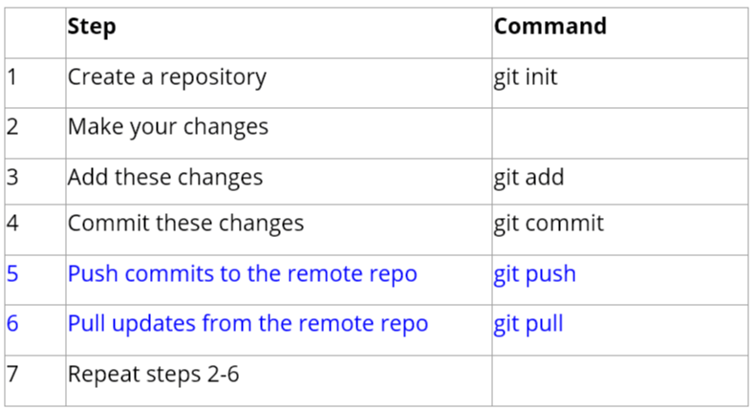
Git Workflow
The Git workflow to work with remotes is as follows:
The last module dealt with the first four steps of the Git workflow. This module deals with steps 5 and 6 of the Git workflow.

Slide 23
Git command line
There are many different ways to use Git. Git supports many command-line tools and graphical user interfaces. The Git command line is the only place where you can run all the Git commands.
Basic Git Commands
Git Config command
Git init command
Git clone command
Git add command
Git commit command
Git status command
Git push Command
Git pull command
Git Branch Command
Git Merge Command
Git log command
Git remote command

Slide 24
Git commands- Config, Init, clone, remote
Git config command
This command configures the user. The Git config command is the first and necessary command used on the Git command line. This command sets the author name and email address to be used with your commits. Git config is also used in other scenarios.
$ git config --global user.name "username@mail.com"
Git Init command
This command is used to create a local repository.
$ git init Demo
Git clone command
This command is used to make a copy of a repository from an existing URL. If I want a local copy of my repository from GitHub, this command allows creating a local copy of that repository on your local directory from the repository URL.
$ git clone URL
Git remote Command
Git Remote command is used to connect your local repository to the remote server. This command allows you to create, view, and delete connections to other repositories. These connections are more like bookmarks rather than direct links into other repositories. This command doesn't provide real-time access to repositories.

Slide 25
Git commands- add, commit
Git add command
This command is used to add one or more files to staging (Index) area.
To add one file
$ git add Filename
To add more than one file
$ git add*
Git commit command
Commit command is used in two scenarios. They are as follows.
Git commit -m
This command changes the head. It records or snapshots the file permanently in the version history with a message.
$ git commit -m " Commit Message"
Git commit -a
This command commits any files added in the repository with git add and also commits any files you've changed since then.
$ git commit -a

Slide 26
Git commands- status, push
Git status command
The status command is used to display the state of the working directory and the staging area. It allows you to see which changes have been staged, which haven't, and which files aren?t being tracked by Git. It does not show you any information about the committed project history. For this, you need to use the git log. It also lists the files that you've changed and those you still need to add or commit.
$ git status
Git push Command
It is used to upload local repository content to a remote repository. Pushing is an act of transfer commits from your local repository to a remote repo. It's the complement to git fetch, but whereas fetching imports commits to local branches on comparatively pushing exports commits to remote branches. Remote branches are configured by using the git remote command. Pushing is capable of overwriting changes, and caution should be taken when pushing.
Git push command can be used as follows.
Git push origin master
This command sends the changes made on the master branch, to your remote repository.
$ git push [variable name] master
Git push -all
This command pushes all the branches to the server repository.
$ git push --all

Slide 27
Git commands- pull, branch, merge, log
Git pull command
Pull command is used to receive data from GitHub. It fetches and merges changes on the remote server to your working directory.
$ git pull URL
Git Branch Command
This command lists all the branches available in the repository.
$ git branch
Git Merge Command
This command is used to merge the specified branch?s history into the current branch.
$ git merge BranchName
Git log Command
This command is used to check the commit history.
$ git log
By default, if no argument passed, Git log shows the most recent commits first. We can limit the number of log entries displayed by passing a number as an option, such as -3 to show only the last three entries.
$ git log -3

Slide 28
Git commands- pull, branch, merge, log
Git pull command
Pull command is used to receive data from GitHub. It fetches and merges changes on the remote server to your working directory.
$ git pull URL
Git Branch Command
This command lists all the branches available in the repository.
$ git branch
Git Merge Command
This command is used to merge the specified branch?s history into the current branch.
$ git merge BranchName
Git log Command
This command is used to check the commit history.
$ git log
By default, if no argument passed, Git log shows the most recent commits first. We can limit the number of log entries displayed by passing a number as an option, such as -3 to show only the last three entries.
$ git log -3

Slide 29
Git Basics ends
Thank you

